Slide 1
Mixed Model
Hierarchical Model

Slide 2
Recap: Determine Fixed and Random Effects
It is up to you to determine what effects in your project
Fixed effects
Factor of specific levels of interest
Objective is to compare group means
Random effect
Levels from a larger population
Can choose different levels if redo the experiment
Objective is to estimate variance
Random effect has additional error terms beyond sigma-square
Important for inferential statistics

Slide 3
Typical Mixed Model Types
RBD (as we covered)
Hierarchical (cover today)
Split Plot (cover next)
Repeated Measures (Cover at the end)

Slide 4
PROC MIXED
Specifically designed to fit mixed effect models.
It can model:
Random and mixed effect data
Repeated measures
Spatial data
Data with heterogeneous variances and autocorrelated observations
The MIXED procedure is more general than GLM in the sense that it gives a user more flexibility in specifying the correlation structures, particularly useful in repeated measures and random effect models
GLM uses OLS estimation
Mixed uses ML, REML, or MIVQUE0 estimation

Slide 5
Hierarchical Model
Predictor variables are measured at more than one level
reading achievement scores at the student level (Level 1)
teacher-student ratios at the school level (Level 2)
Response is measured for each subject (level 1)
Each subject then belongs to a group (cluster) (level 2)
Math scores of students grouped by classroom, or school
Birth weights of lab rats grouped by litter

Slide 6
Example
High School and Beyond data example (Byrk & Raudenbush, 1992)
7,185 students in 160 schools
MATHACH: Student level (level-1) outcome is math achievement
SES: Student level (levl-1) covariate is socio-economic status
MEANSES: School-level (level-2) covariate of mean SES for the school
SECTOR: School-level (level-2) covariate of school type (dummy coded, public= 0 and Catholic=1)

Slide 7
MIXED Model Level 2 Approach
Level 1: students outcome (Y_{ij}) is expressed as the sum of an intercept for the students school (β_{0j}) and a random error term (r_{ij}) associated with the i_{th} student in the j_{th} school
Y_{ij} = β_{0j} + r_{ij}
Level 2: We express the school level intercept as the sum of an overall mean (γ₀₀) and a series of random deviations from that mean (μ_{0j}).
β_{0j} = γ₀₀ + γ₀₁MEANSES_{j} + γ₀₂SECTOR_{j} + μ_{0j}
This leads to a model equation of
Y_{ij} = γ₀₀ + γ₀₁MEANSES_{j} + γ₀₂SECTOR_{j} + μ_{0j} + r_{ij}
SAS syntax
proc mixed data=hsb2 covtest; class school sector; model mathach = meanses sector/solution ddfm=satterthwaite; random intercept /sub=school type=un; lsmeans sector; run;

Slide 8
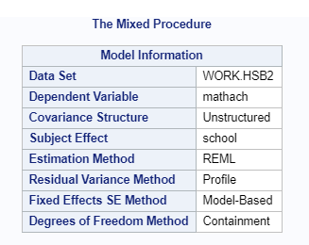
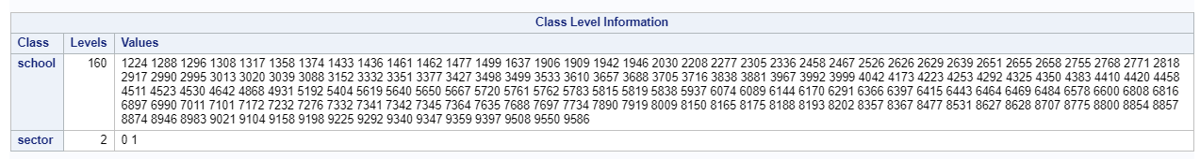
Level 2 as Predictor Variables
filename input '/folders/myshortcuts/Math318/my_download/hsball.txt'; data hsb2; infile input missover firstobs=2 dlm='09'x; input school $ minority $ female $ ses mathach sector meanses; cards; proc sort; by school; run; proc mixed data=hsb2 covtest; class school sector; model mathach = meanses sector/solution
ddfm=satterthwaite; random intercept /sub=school; lsmeans sector; run;

Slide 9
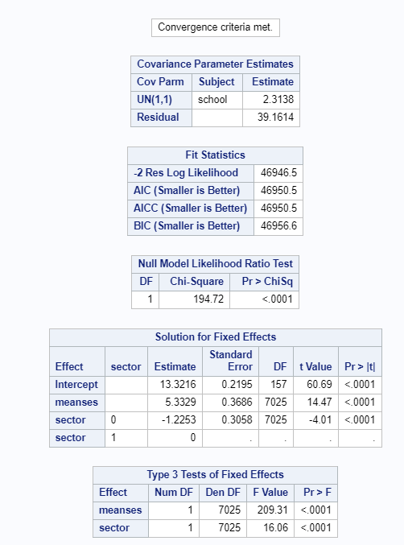
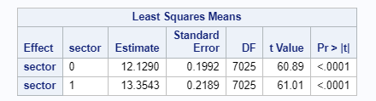
Variance between school is 2.64 Variance within school is 39.16
SAS Output
13.32 is the average school mean math achievement score when the rest predictors are zero
5.333 is the fixed effects for meanses: schools that differ by 1 point in meanses differ by 5.333 points in mathach and is a significant effect

Slide 10
Including Level-1 Predictors
Student-level (level-1) predictor of SES
Level 1: students outcome (Y_{ij}) is expressed as a function of an intercept for the students school (β_{0j}), individual CSES (centered by MEANSES), and a random error term (r_{ij}) associated with the i_{th} student in the j_{th} school
Y_{ij} = β_{0j} + β_{1j}SES_{ij} +r_{ij}
Level 2: We express the school level intercept as the sum of an overall mean (γ₀₀) and a series of random deviations from that mean (μ_{0j}).
β_{0j} = γ₀₀ + μ_{0j}
β_{1j} = γ₁₀ + μ_{1j}
This leads to a model equation of
Y_{ij} = [γ₀₀ + γ₀₁SES_{j} ] + [μ_{0j} + μ_{1j}(SES)+ r_{ij} ]
SAS syntax
proc mixed noclprint covtest noitprint;
class school;
model mathach = ses/solution ddfm=bw notest;
random intercept ses/sub=school type = un;
Notes:
NOINTPRINT =
NOTEST =
TYPE = UN =>

Slide 11
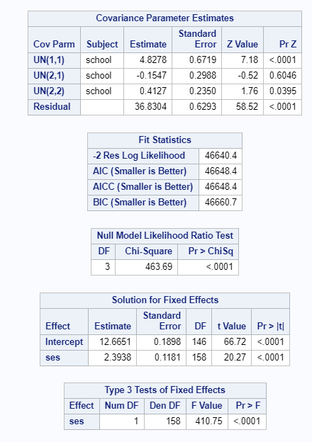
Variance between school is 4.83 Variance from SES is 0.4127 Variance within school is 36.83 reduced from 39.16
12.67 is the average school mean math achievement score when the rest predictors are zero
2.39 is the fixed effects for ses: students that differ by 1 point in ses differ by 2.39 points in mathach and is a significant effect

Slide 12
Including Level-1 AND Level-2 Predictors
Model with the effect of students SES (SES) and school SES (MEANSES) with a second level-2 factor of SECTOR
Y_{ij} = β_{0j} + β_{1j}SES_{ij} +r_{ij}
β_{0j} = γ₀₀ + γ₀₁MEANSES_{j} + γ₀₂SECTOR_{j} + μ_{0j (private school)}
β_{1j} = γ₁₀ + γ₁₁MEANSES_{j} + γ₁₂SECTOR_{j} + μ_{1j (public school)}
This leads to a model equation of
Y_{ij} = γ₀₀ + γ₀₁MEANSES_{j} + γ₀₂SECTOR_{j} + γ₁₀SES_{ij}
+ γ₁₁MEANSES_{j}(SES_{ij}) + γ₁₂SECTOR_{j}(SES_{ij})
+ μ_{0j} + μ_{1j}(SES_{ij}) + r_{ij}
SAS syntax (interactions not included in the model)
proc mixed data=hsb2 covtest; class school sector; model mathach = meanses sector ses/solution ddfm=satterthwaite; random intercept ses/sub=school type=un solution; lsmeans sector; contrast 'private vs public' sector -1 1; estimate 'private vs public' sector -1 1; run;
Notes:
NOINTPRINT =
NOTEST =
TYPE = UN =>

Slide 13
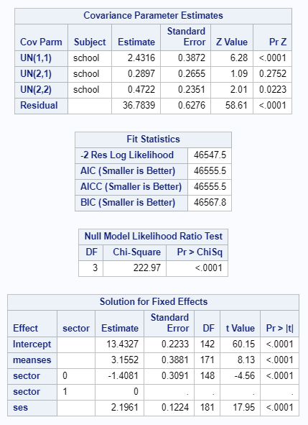
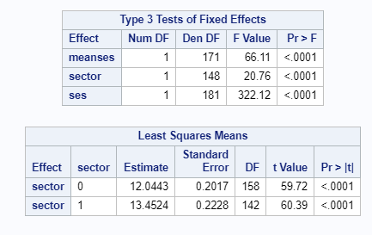
Level 1&2 as Predictor Variables
proc mixed data=hsb2 covtest; class school sector; model mathach = meanses sector ses/solution ddfm=satterthwaite; random intercept ses /sub=school; lsmeans sector; run;

Slide 14
Quiz 5
For Level 1 & 2 as Predictor model, Interpret the meaning of the Covariance Parameter Estimates (3 points)
for the above model, find the random effect BLUP for school 8707 (3 points)
Write a brief summary of this analysis (4 points)

